Slide 1
Quiz Mobile App Development Project

Slide 2
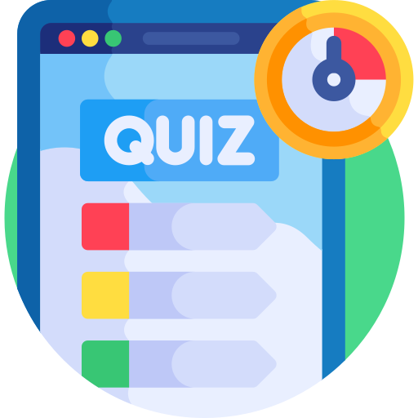
Identify the Problem
Overcome the time consuming problem of manual system.
Checking the answer sheets after taking test.
Waste of money for paper, printing, distribution.
Waste the examiners time.
Waste the user time also.
User wait for there results

Slide 3
Identify the Problem
The Quiz Application project will be developed to overcome the time consuming problem of manual system.
Apart from that in current system, checking the answer sheets after taking test, waste the examiners time, so this application will check the correct answer and save the examiner time and carry the examination in an effective manner.
The users which are use this system don’t need to high computing knowledge and also system will inform them while entering invalid data

Slide 4
Interactive Interface
User Friends Interface
Easy to use
Inform the user while entering invalid data
This system don’t need to high computing knowledge.
Step by step Inform the user what to do now

Slide 5
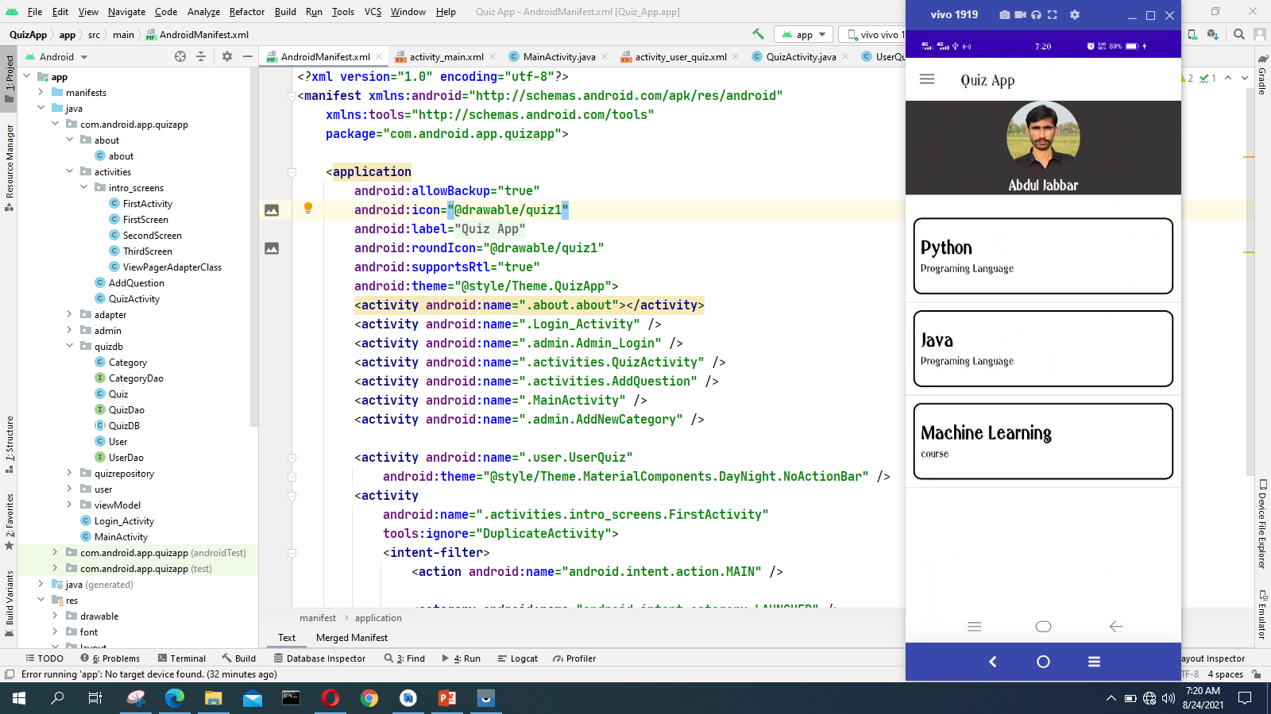
Originality of Project
I have done code myself as shown by Screenshot

Slide 6
Problem Solution
The aim of this project is to computerized the existing manual system and help the examiners to save their valuable time
The project will reduce the manual process in managing examinations and all issues
Correct answers will be evaluated by system (First it should be determining by examiner)
Users can see their result after submitting the test.

Slide 7
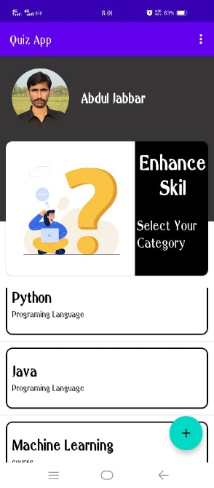
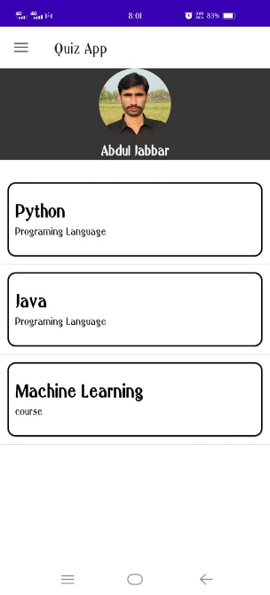
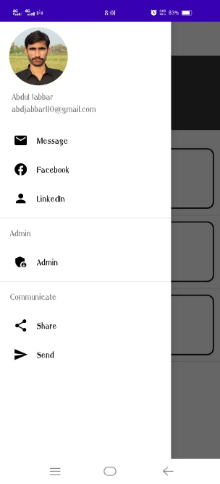
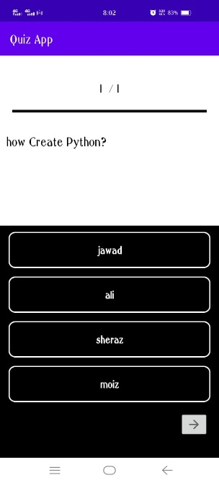
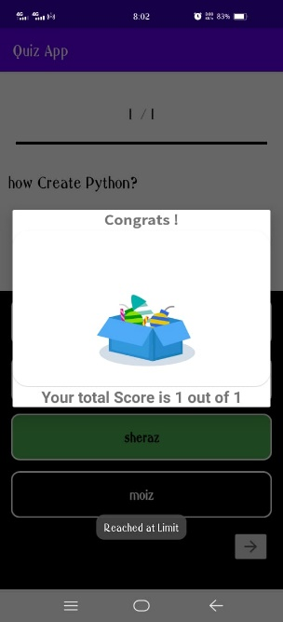
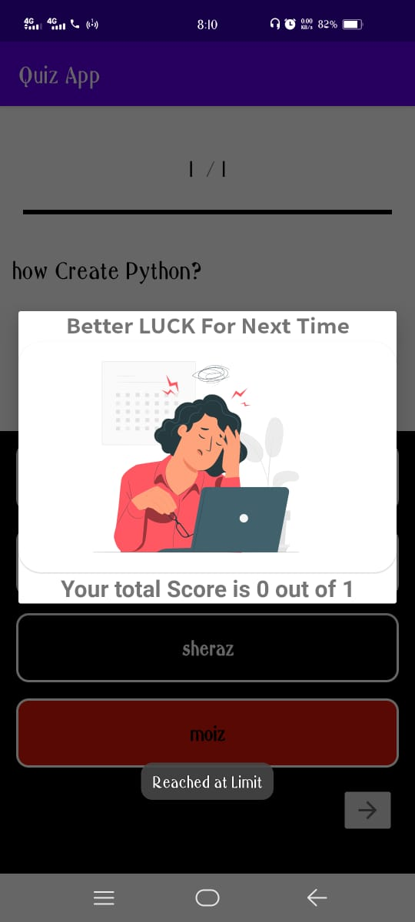
Completeness
Complete all thing but without registration part
Complete User Quiz part, user can start quiz

Slide 8


Slide 9
Contact
Email: abdjabbar110@gmail.com
LinkedIn: https://www.linkedin.com/in/abdul-jabbar-7b1401132/
GitHub: https://github.com/AbdulJabbar64/Android-Project-Quiz-app/tree/master
Project Video Link: https://drive.google.com/drive/folders/1sQNFat_OhPgRG0k8Ti7SLontUaeY9v1r?usp=sharing

